Slide 1
Highly Pathogenic Avian Influenza (HPAI)
Update for Local Health Departments April 2, 2024

Slide 2
Agenda
Background on Highly Pathogenic Avian Influenza (HPAI)
Situation Update
Public Health Recommendations and LHD Role
2

Slide 3
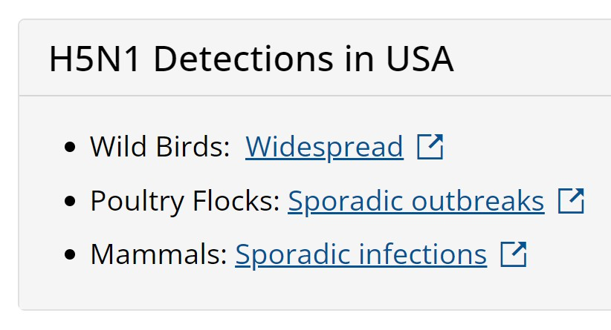
There is an ongoing panzootic of HPAI
Influenza A virus H5N1 clade 2.3.4.4b
Predominant in Asia, Africa, Europe and the Middle East by late 2021
First outbreaks in US in Feb. 2022
Outbreaks have affected:
Commercial poultry
Backyard bird flocks
Spread to infect wild terrestrial and
marine mammals, and
domesticated animals.
More from CDC here: https://www.cdc.gov/flu/avianflu/avian-flu-summary.htm
3

Slide 4
Sporadic cases of HPAI A(H5N1) have been reported in humans
Since 1997, human infections have been reported in 23 countries
Estimated case fatality proportion of >50%
Since 2022, only a small number of human H5N1 cases have been reported
2022, 1 human infection with HPAI occurred in the US following exposure to infected poultry.
Most human infections have occurred after unprotected exposures to sick or dead infected poultry
No evidence of sustained human-to-human H5N1 virus transmission
Limited, non-sustained human-to-human H5N1 virus transmission has not been reported worldwide since 2007

Slide 5
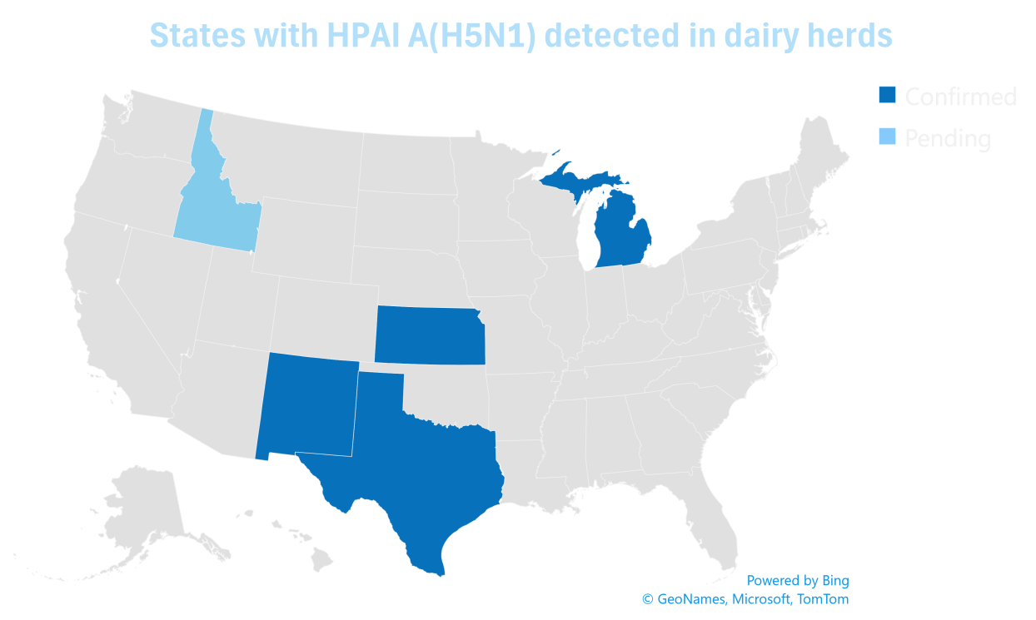
US Dept of Agriculture (USDA) recently reported HPAI in dairy cows
As of April 1, 2024, USDA has confirmed HPAI A(H5N1) in
dairy cows in 4 states
Texas (7 herds)
Kansas (2 herds)
New Mexico (1 herd)
Michigan (1 herd)
All viruses identified in cows to date are from the genetic clade 2.3.4.4b.

Slide 6
On April 1, a person in Texas tested positive for HPAI following exposure to cattle
Exposure to cattle presumed to be infected with HPAI
Only symptom was conjunctivitis
Person is recovering
Treated with antivirals
Instructed to isolate

Slide 7
H5N1 risk for the US general public continues to be low.
Persons at greater risk of infection: close or prolonged, unprotected exposures to infected birds or animals (including livestock), or to environments contaminated by these animals
Preliminary analyses indicate that HPAI A(H5N1) viruses are susceptible to available antiviral treatments
Seasonal flu vaccines do not
provide protection against HPAI
No vaccines currently on the market
protect against HPAI
Candidate vaccines are being explored

Slide 8
CDC recommendations for prevention
For the general public:
Avoid unprotected exposures to sick or dead animals
Do not eat or prepare uncooked or undercooked food products (e.g. raw milk, raw cheeses) from animals with suspected or confirmed infection
Farmers/Livestock owners/Workers:
Avoid unprotected exposures to sick or dead animals and their environment
Wear appropriate PPE when handling potentially infected animals or materials

Slide 9
Recommendations for Public Health Investigation and Local Health Department Role
Monitor people with exposure to animals infected with HPAI.
Individuals with known exposures to HPAI-positive animals (poultry, backyard flocks, etc.)
Public health is notified of exposed individuals by USDA or CT Dept. of Agriculture
Exposed individuals are monitored for 10 days following their last known exposure
Infected individuals typically exhibit upper or lower respiratory symptoms; GI symptoms may also be possible. Range of severity might be observed:
Mild illness (e.g., cough, sore throat, eye redness or eye discharge such as conjunctivitis, fever or feeling feverish, rhinorrhea, fatigue, myalgia,
arthralgia, headache)
Moderate to severe illness (e.g., shortness of breath or difficulty breathing, altered mental status, seizures)
Complications: pneumonia, respiratory failure, acute respiratory distress syndrome, multi-organ failure (respiratory and kidney failure), sepsis,
meningoencephalitis
Individuals with clinically compatible symptoms and exposure history should be tested.
Notify DPH epidemiologist on call if a person under monitoring develops symptoms
See SPHL influenza testing for guidance on specimen collection and submission
Symptomatic individuals should self-isolate away from others
In a clinical setting standard, contact, and airborne precautions should be used for patient care and evaluation

Slide 10
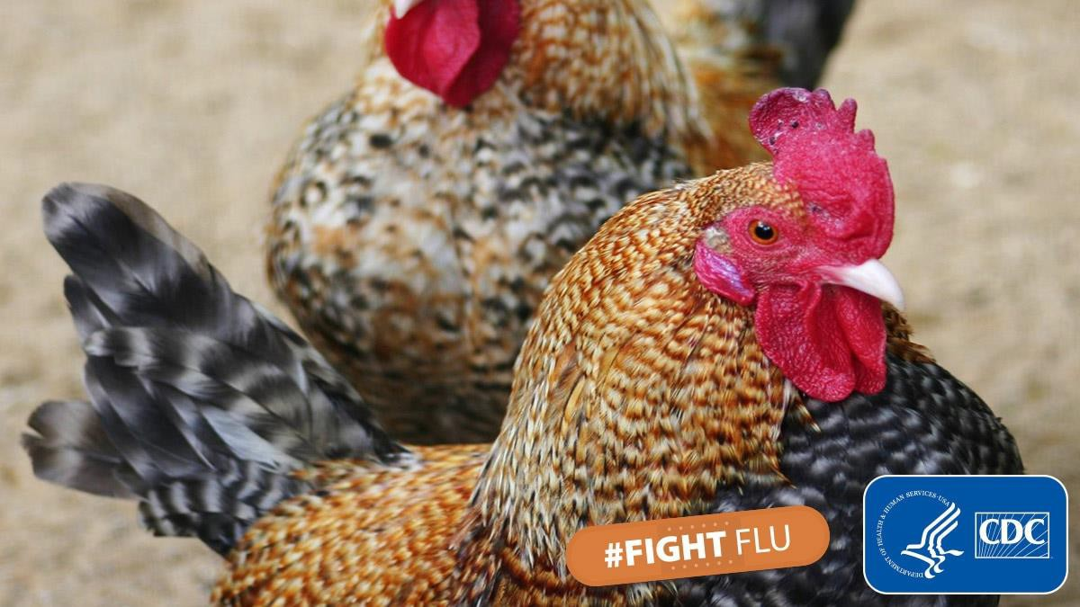
For more information
CT DPH press release
CDC Current Situation
Summary
CDC Interim Recommendations for
Prevention, Monitoring and
Public Health Investigations
CDC Avian Influenza
Communications Resources
CDC Media Release: HPAI
Infection Reported in a Person
in the US (April 1, 2024)

Slide 11
Additional resources
DEEP, How to resport dead birds: https://portal.ct.gov/DEEP/Wildlife/Avian- Influenza#report
Uconn Veterinary Medical Diagnostic Laboratory: Home | Connecticut Veterinary Medical Diagnostic Laboratory (uconn.edu)

