Slide 1

ABOUT CRAHD

Slide 2
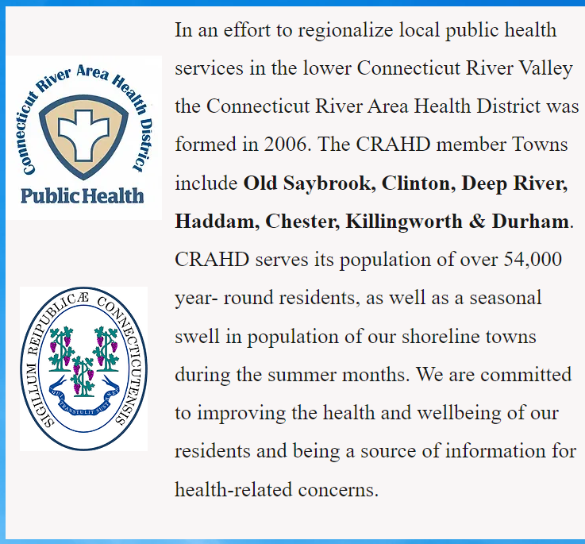

Slide 3

1. A professional department staffed with trained and certified personnel with expertise in a wide variety of public health areas
2. Improved availability of services: seven days a week, 24 hours a day for emergencies
3. Reduction of fragmented services
4. Uniform enforcement of state laws, regulations, codes, and ordinances
5. Regional approach to address public health problems that cross town lines
6. Ability from member towns to pool staff, resources, and services in times of need
7. Greater capability and capacity to address a wider scope of public health concerns
8. Increased efficiency and utilization of resources through collaborative problem identification, priority setting, and coordination
9. Increased eligibility for additional state and federal funding thereby bringing dollars to the local level that might not otherwise be possible
10. Enhanced networking opportunities for your town to develop partnerships with other local health departments and state agencies
What is a district department of health?
A district department of public health or “health district” is a regional public health department formed by two or more municipalities to provide local public health services. A health district is a separate governmental entity from the town it serves. It is funded through: Town and State Per Capita, Permit & Application Fees & Government and Private Grants.
There are many benefits to being a member town of a health district.

Slide 5
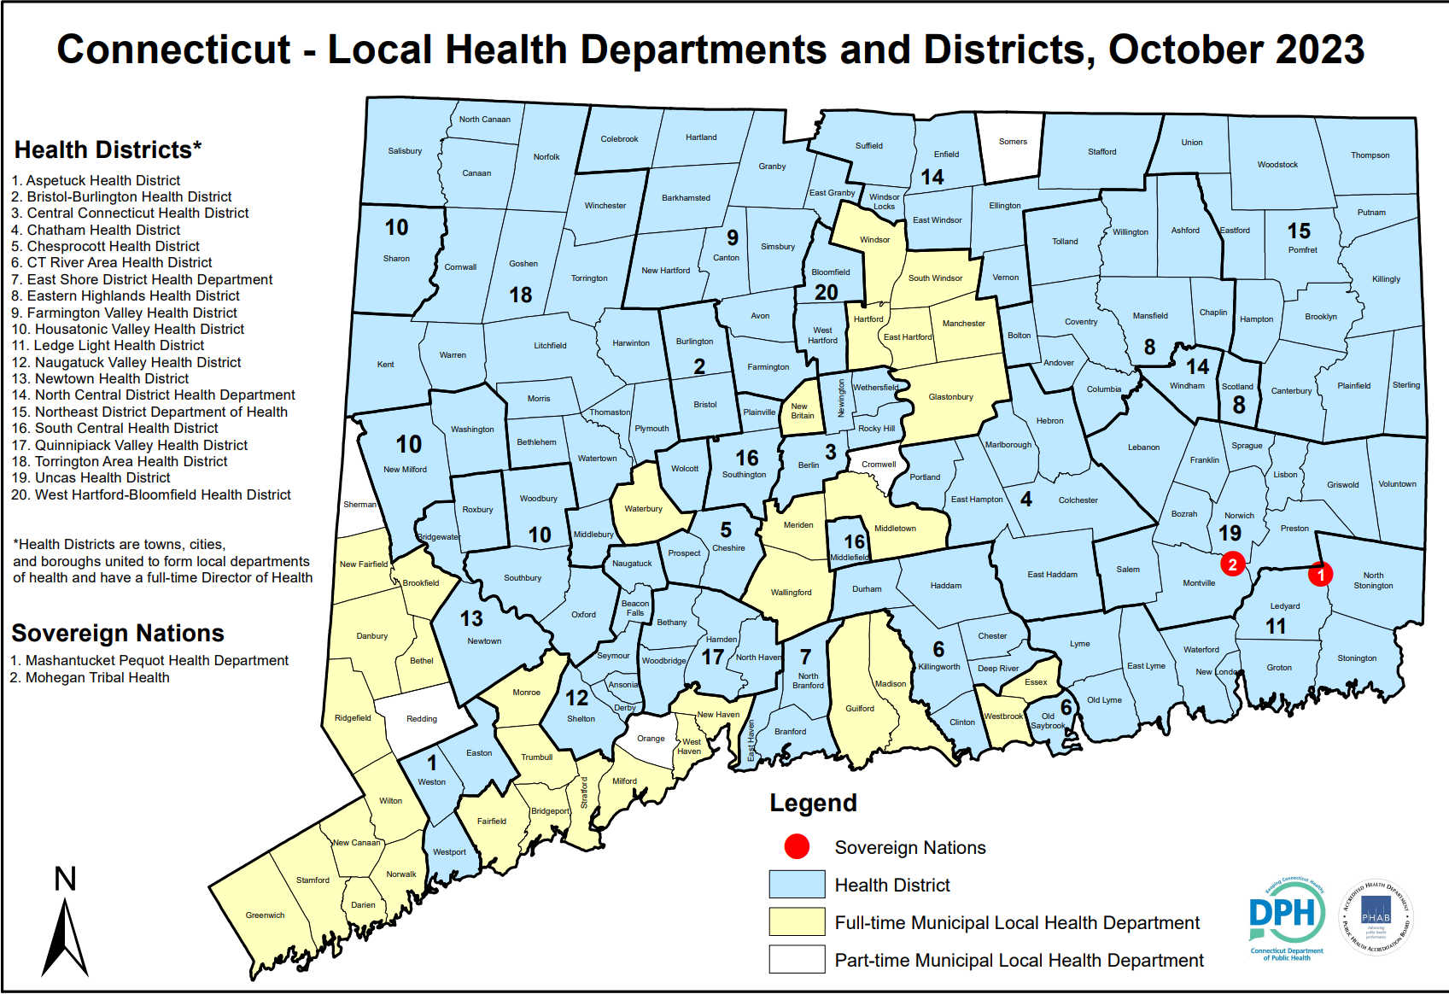

Slide 6
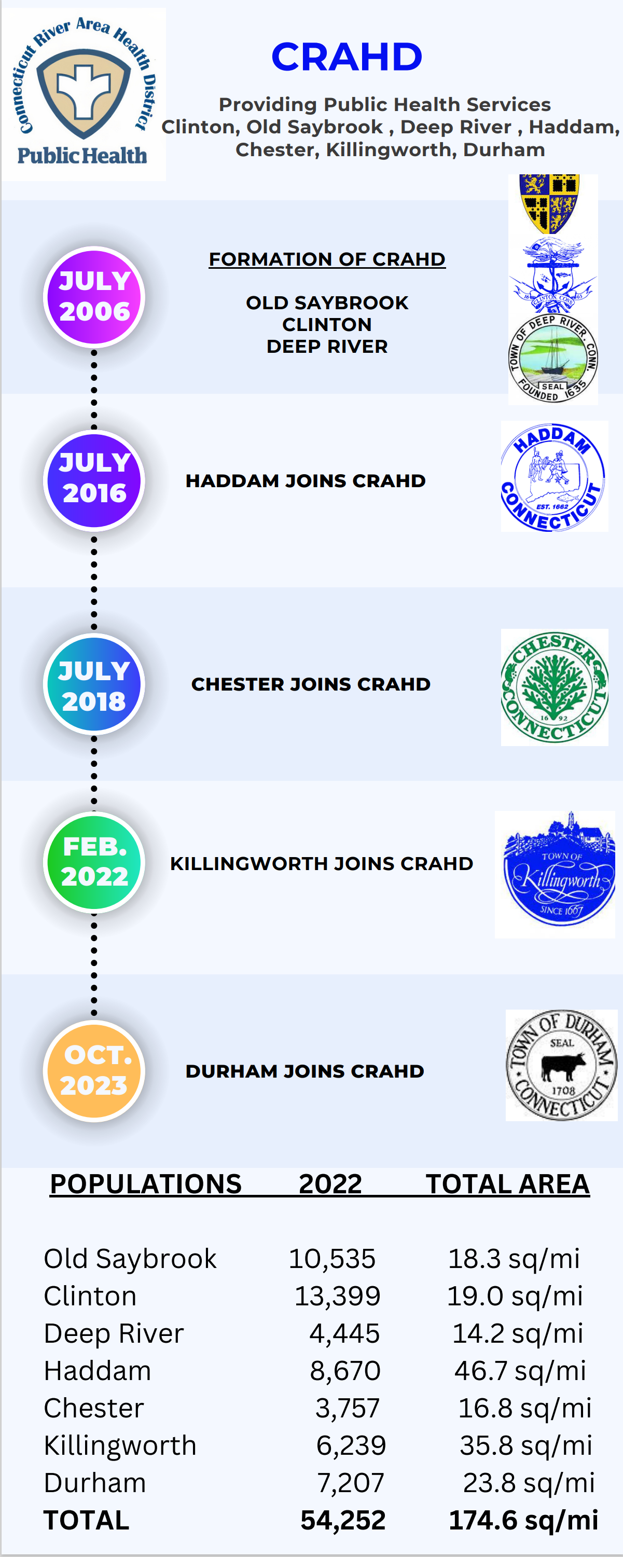
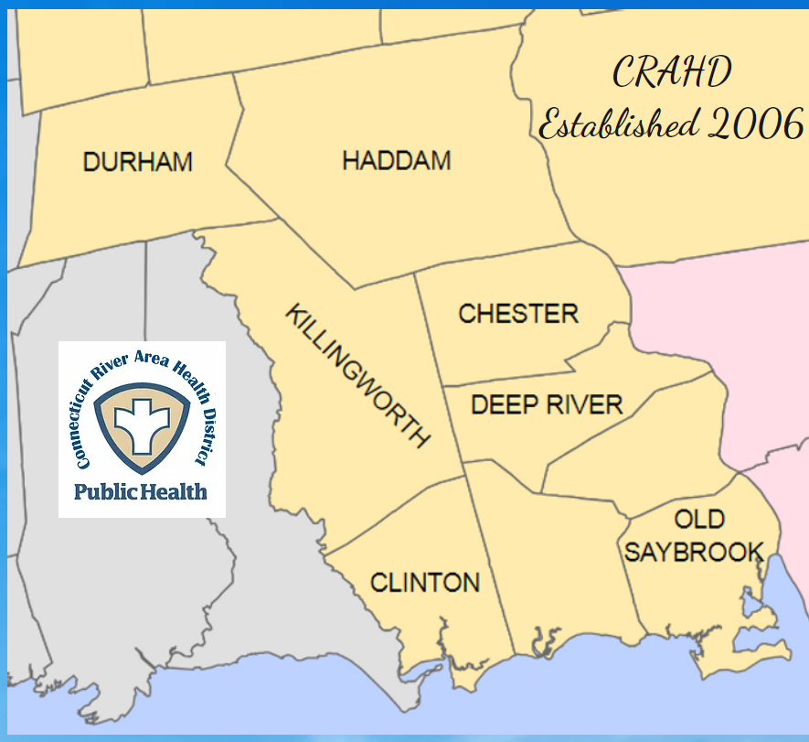

Slide 7
CRAHD MEMBER TOWN DEMOGRAPHICS 2023 DATA

Slide 8


Highlights of what we do
ENVIRONMENTAL HEALTH
Inspection programs include state-mandated inspections for compliance with the Connecticut Public Health Code, applicable General Statutes and Local Ordinances.
Inspections, permitting/licensing activities, and targeted education are conducted in the following areas:
On-site sewage disposal: soil site evaluations, installer, and engineered plan reviews, permitting for new, upgraded, altered, and repaired systems, installation inspections, as-built drawing review, issuance of permits to discharge.
Food service establishments: restaurants, caterers, food stores, school cafeterias, nursing homes, churches, vendors, temporary events, and farmer’s markets.
Body care establishments: cosmetology shops, nail and beauty salons, and barber shops.
Child day care centers and group day care homes.
Overnight-stay facilities such as hotels, motels, inns, bed & breakfasts.
Public swimming pools, including spas and condominium pools.
Public bathing areas include freshwater bathing and marine water beaches.
General Nuisance/Other Complaints: CRAHD Sanitarians respond to a variety of citizens’ complaints such as: housing, rodent infestation, garbage and odors, septic overflows, general nuisance, well and water supply issues, and poor sanitary conditions.
Private water supplies permitting, location approvals, testing, lab report reviews, advice on treatment and maintenance.
Campgrounds: Inspections to ensure minimum sanitary standards
Childhood Lead Poisoning Prevention: Lead Paint hazard reduction, abatement orders, education to homeowners, tenants, and property owners. Case follow up of childhood elevated blood lead levels.
Housing: landlord-tenant issues related to minimum housing standards

Slide 9
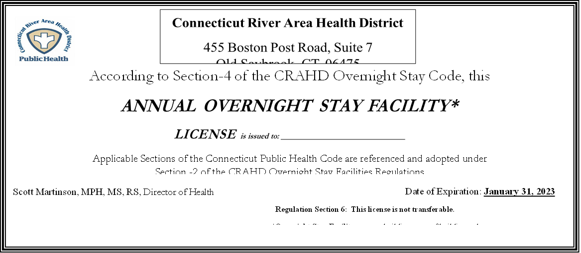
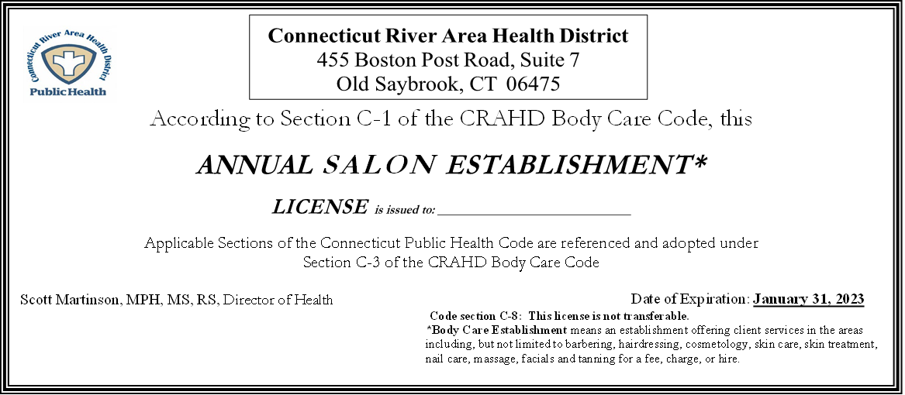


WHO DO WE LICENSE/REGULATE????????
319 FOOD SERVICE ESTABLISHMENTS
7 ITINERANT FOOD TRUCKS
15 YEARLY TEMPORARY EVENTS(Hundreds of Food Vendors)
87 SALONS
13 OVERNIGHT STAYS
24 PUBLIC POOLS
19 DAYCARES

Slide 10
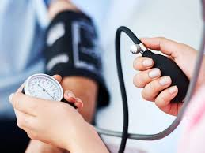
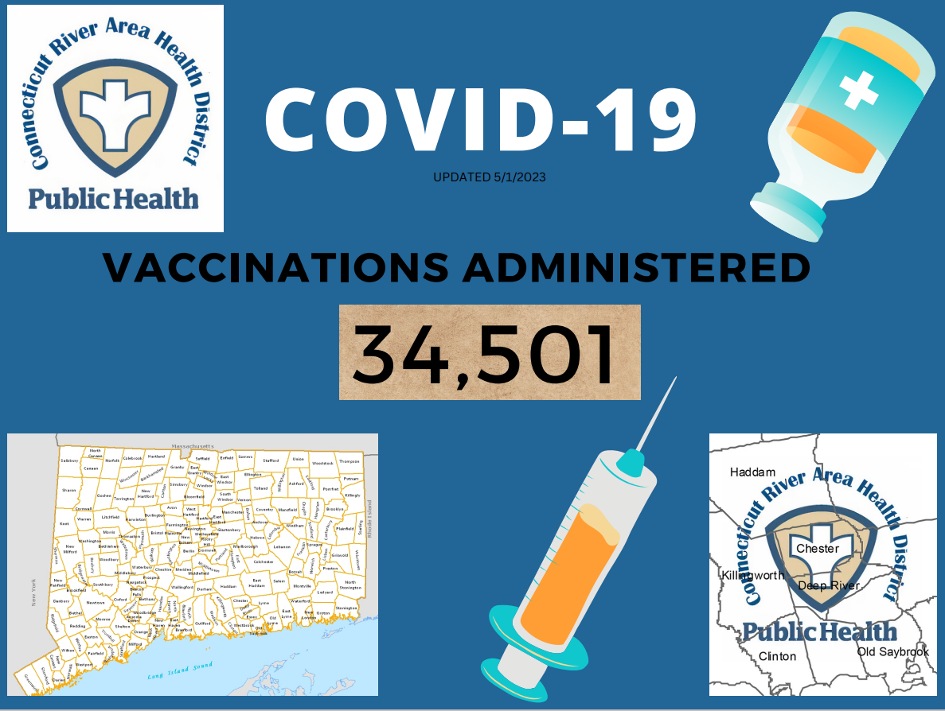

COMMUNITY HEALTH
Emergency Preparedness:
CRAHD is the lead health department previously referred to as Mass Dispensing Area #39, which includes the 7 health district towns as well as Westbrook, Essex. CRAHD continues to meet with its Emergency Support Function (ESF) eight; Medical and Public Health partners in DEMHS region two and statewide to enhance regional capacity and to develop regional health care coalitions. CRAHD has reviewed and changed the structure of its PHERP. All Preparedness plans are periodically reviewed. CRAHD conducts local communications exercises on a quarterly basis and participates in regional and statewide drills and exercises.
Surveillance:
CRAHD conducts active surveillance of all laboratories and physician reported diseases identified by the CT DPH. The CRAHD also conducts follow-up investigations of selected illnesses reported to control the spread of these diseases in the community.
Vaccinations:
Mass Vaccinations, Office Clinics, Home Visits
FLU & COVID
Community Health Programs:
Examples: Blood Pressure, Asthma, Skin Cancer
Highlights of what we do

Slide 11
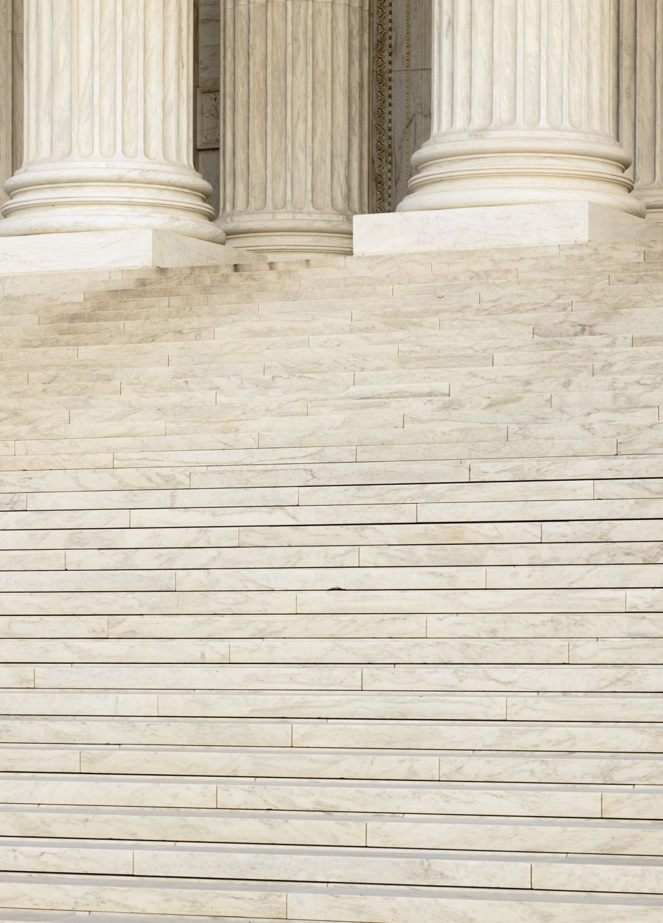
The CRAHD is composed of 7 municipalities which have voted to join the district by their representative legislative bodies pursuant to Section 19a-241(a) of the Connecticut general statutes.
The CRAHD is governed by a Board of Directors (the Board) made up of representatives (Directors) appointed by Member Towns of the health district pursuant to Section 19a-241(b) of the Connecticut General Statutes. Each municipality in the district may appoint one Director to the Board for each 10,000 population or part thereof.
Board Position Name Town
Chair Michael Dunne, M.D. Old Saybrook
Director Carol Jones Deep River
Director Alan Schwarz, M.D. Old Saybrook
V. Chair Rita Foster, RN, MSN Clinton
Director Michelle Benivegna Clinton
Director Robert McGarry Haddam
Director Cynthia Lignar Chester
Director Eric Couture Killingworth
Director William Kohlhepp, DHSc, PA-C Durham

Slide 12
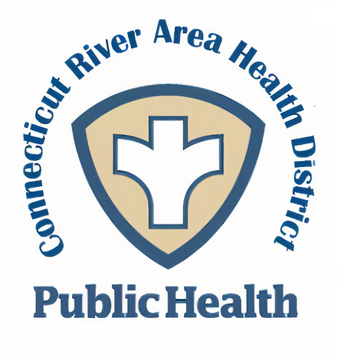
CRAHD STAFF
FT Staff Position Name
Director of Health Scott Martinson, MPH, MS, RS
Registered Sanitarian Ryan Grenon, MPA, RS
Registered Sanitarian Greg Mattus, MA, RS
Registered Sanitarian Rebecca Drew, BS, RS
Registered Sanitarian Melissa Neri, BS, RS
Public Health Nurse Sherry Carlson, BSN, RN
Office Manager Karina Maynard
80 Years of Public Health Experience
32 Years of Secondary Education

Slide 13
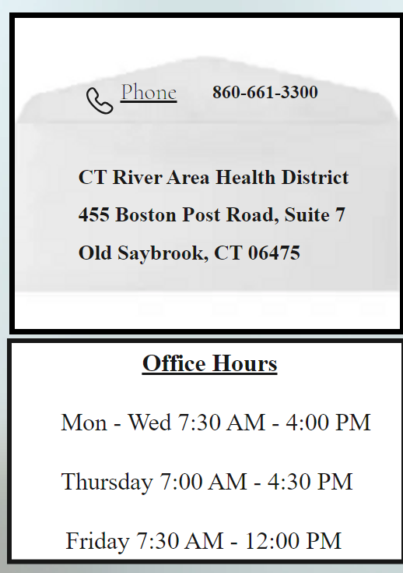

General Email: crahdoffice@crahd.net
Website: www.crahd.info

Slide 14


